Slide 1
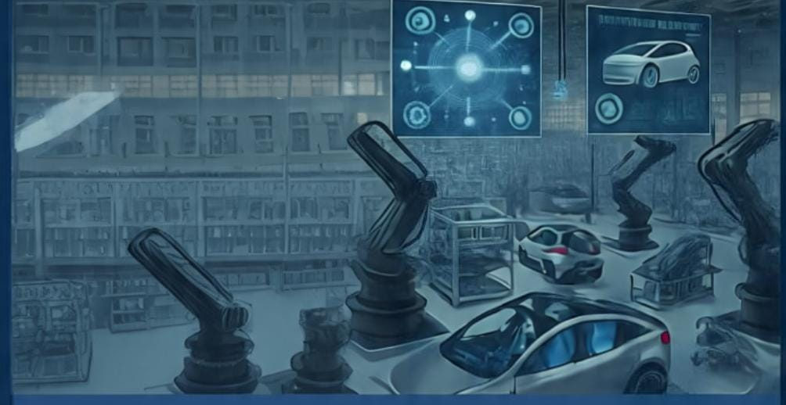
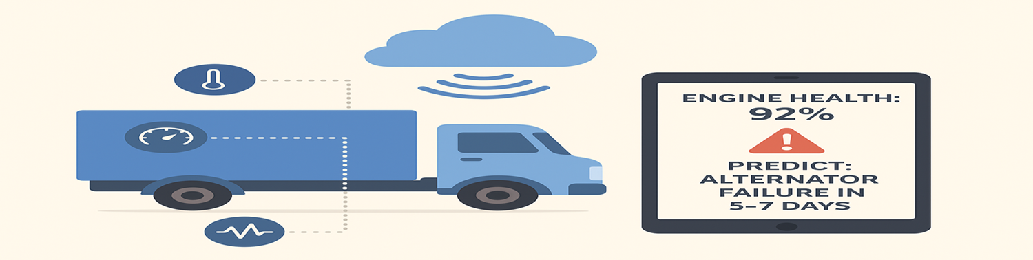
AUTOPREDICT
From Reactive Repairs to Proactive Predictions
Real-Time Health Monitoring
Live data from ENGINE, BATTERY and more
AI powered predictions
Forecast failures days in advance
Actionable alerts
Prioritized maintenance recommendation
Eliminate downtime Cut Maintenance Costs
Increase Fleet lifespan Ensure Delivery Schedules
Actionable alerts
Prioritized maintenance recommendations
Cost dashboard
Track savings and RIO
SMARTER, SAFER & STRONGER
Vaal University of Technology| Business Analysis 3.2 project(TechPulse)| 2025
Notes:
SMARTER, SAFER & STRONGER

